Slide 1


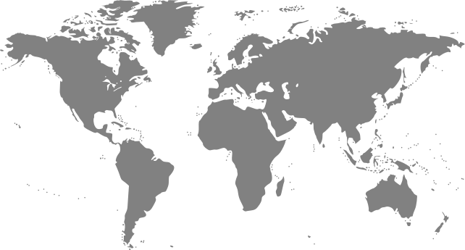

Airbnb
Major World Cities Guide
Columbia University
Data Bootcamp
Group Project 1
June 30, 2020
Notes:
Caiti - Welcome

Slide 2



The Team
Caiti Donovan
Amanda Luna
Yuly Alcantara
Notes:
Caiti – Our team

Slide 3

Introduction
The Data
We found a multi-city/global dataset with information on Airbnb listings from cities around the world.
The Sample City
Using just Seattle as a model, we’ve analyzed the listings to determine what kind of Airbnb experience you can expect to have when traveling to Seattle.
The Model
Applying the same code/process to the other cities in the world dataset we can create a full world guide to help people better choose their travel destinations.
Notes:
Caiti – Dataset we found and setting up the model
Hand over to Amanda to speak to why we chose Seattle and give overview of our analysis (next slide)

Slide 4

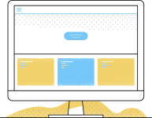


Our Analysis
1. Availability and Pricing
2. Types of Properties/Rooms
3. Types of Hosts
Notes:
Amanda

Slide 5
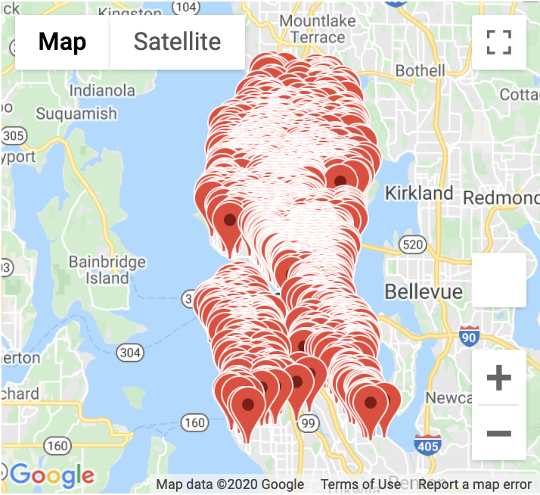
1
Availability
and Pricing
Total number of available properties:
3,818
PITCH DECK V 1.0
Notes:
Amanda
Seattle has plenty of properties available for rent year round!

Slide 6
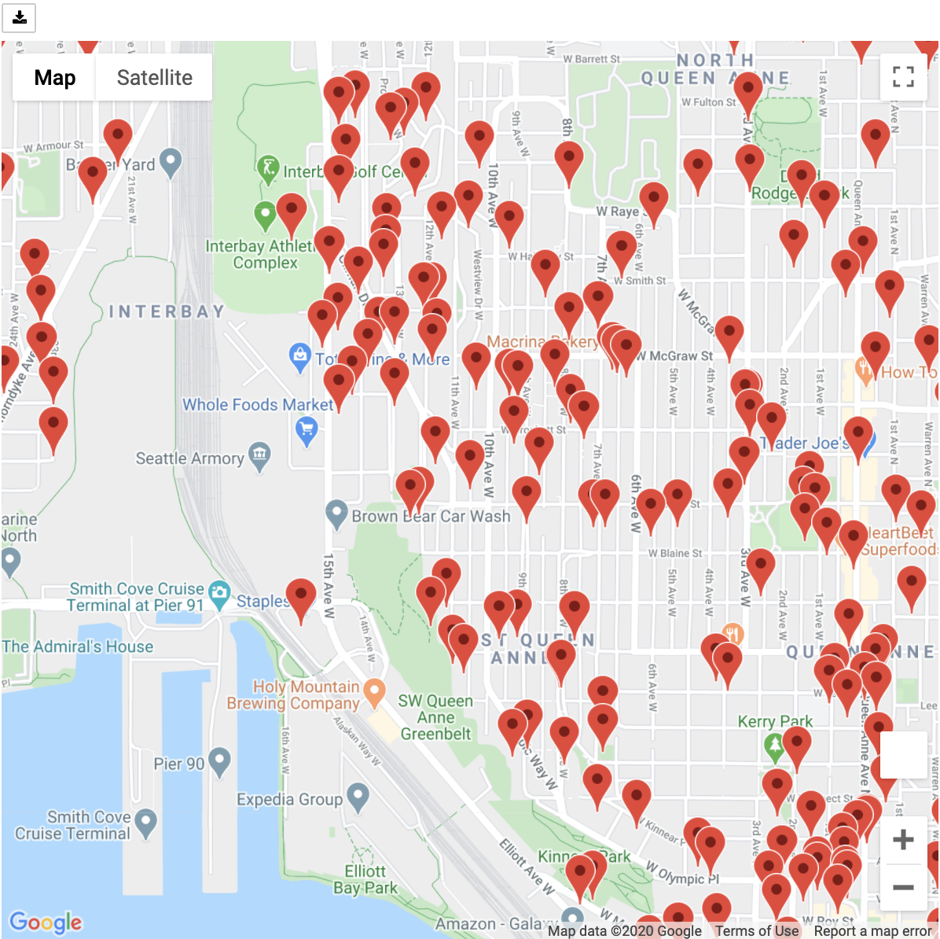
1
Availability
and Pricing
Closer look at Queen Anne neighborhood
PITCH DECK V 1.0
Notes:
Amanda
When we zoom in on the Queen Anne neighborhood, we can further see how saturated the market is with listings.

Slide 7
1
Availability
and Pricing
Average nightly price:
$127.98
Typical max nightly price:
$262.50
Notes:
Amanda
Accommodation is usually one of the top three highest expenses to budget for when travelling, but nightly prices are very reasonable in Seattle allowing for more budget to go to food and activities!
Only 246 (6.4%) of properties cost more than the max
[Transition to Caiti for Types of Properties/Rooms]

Slide 9
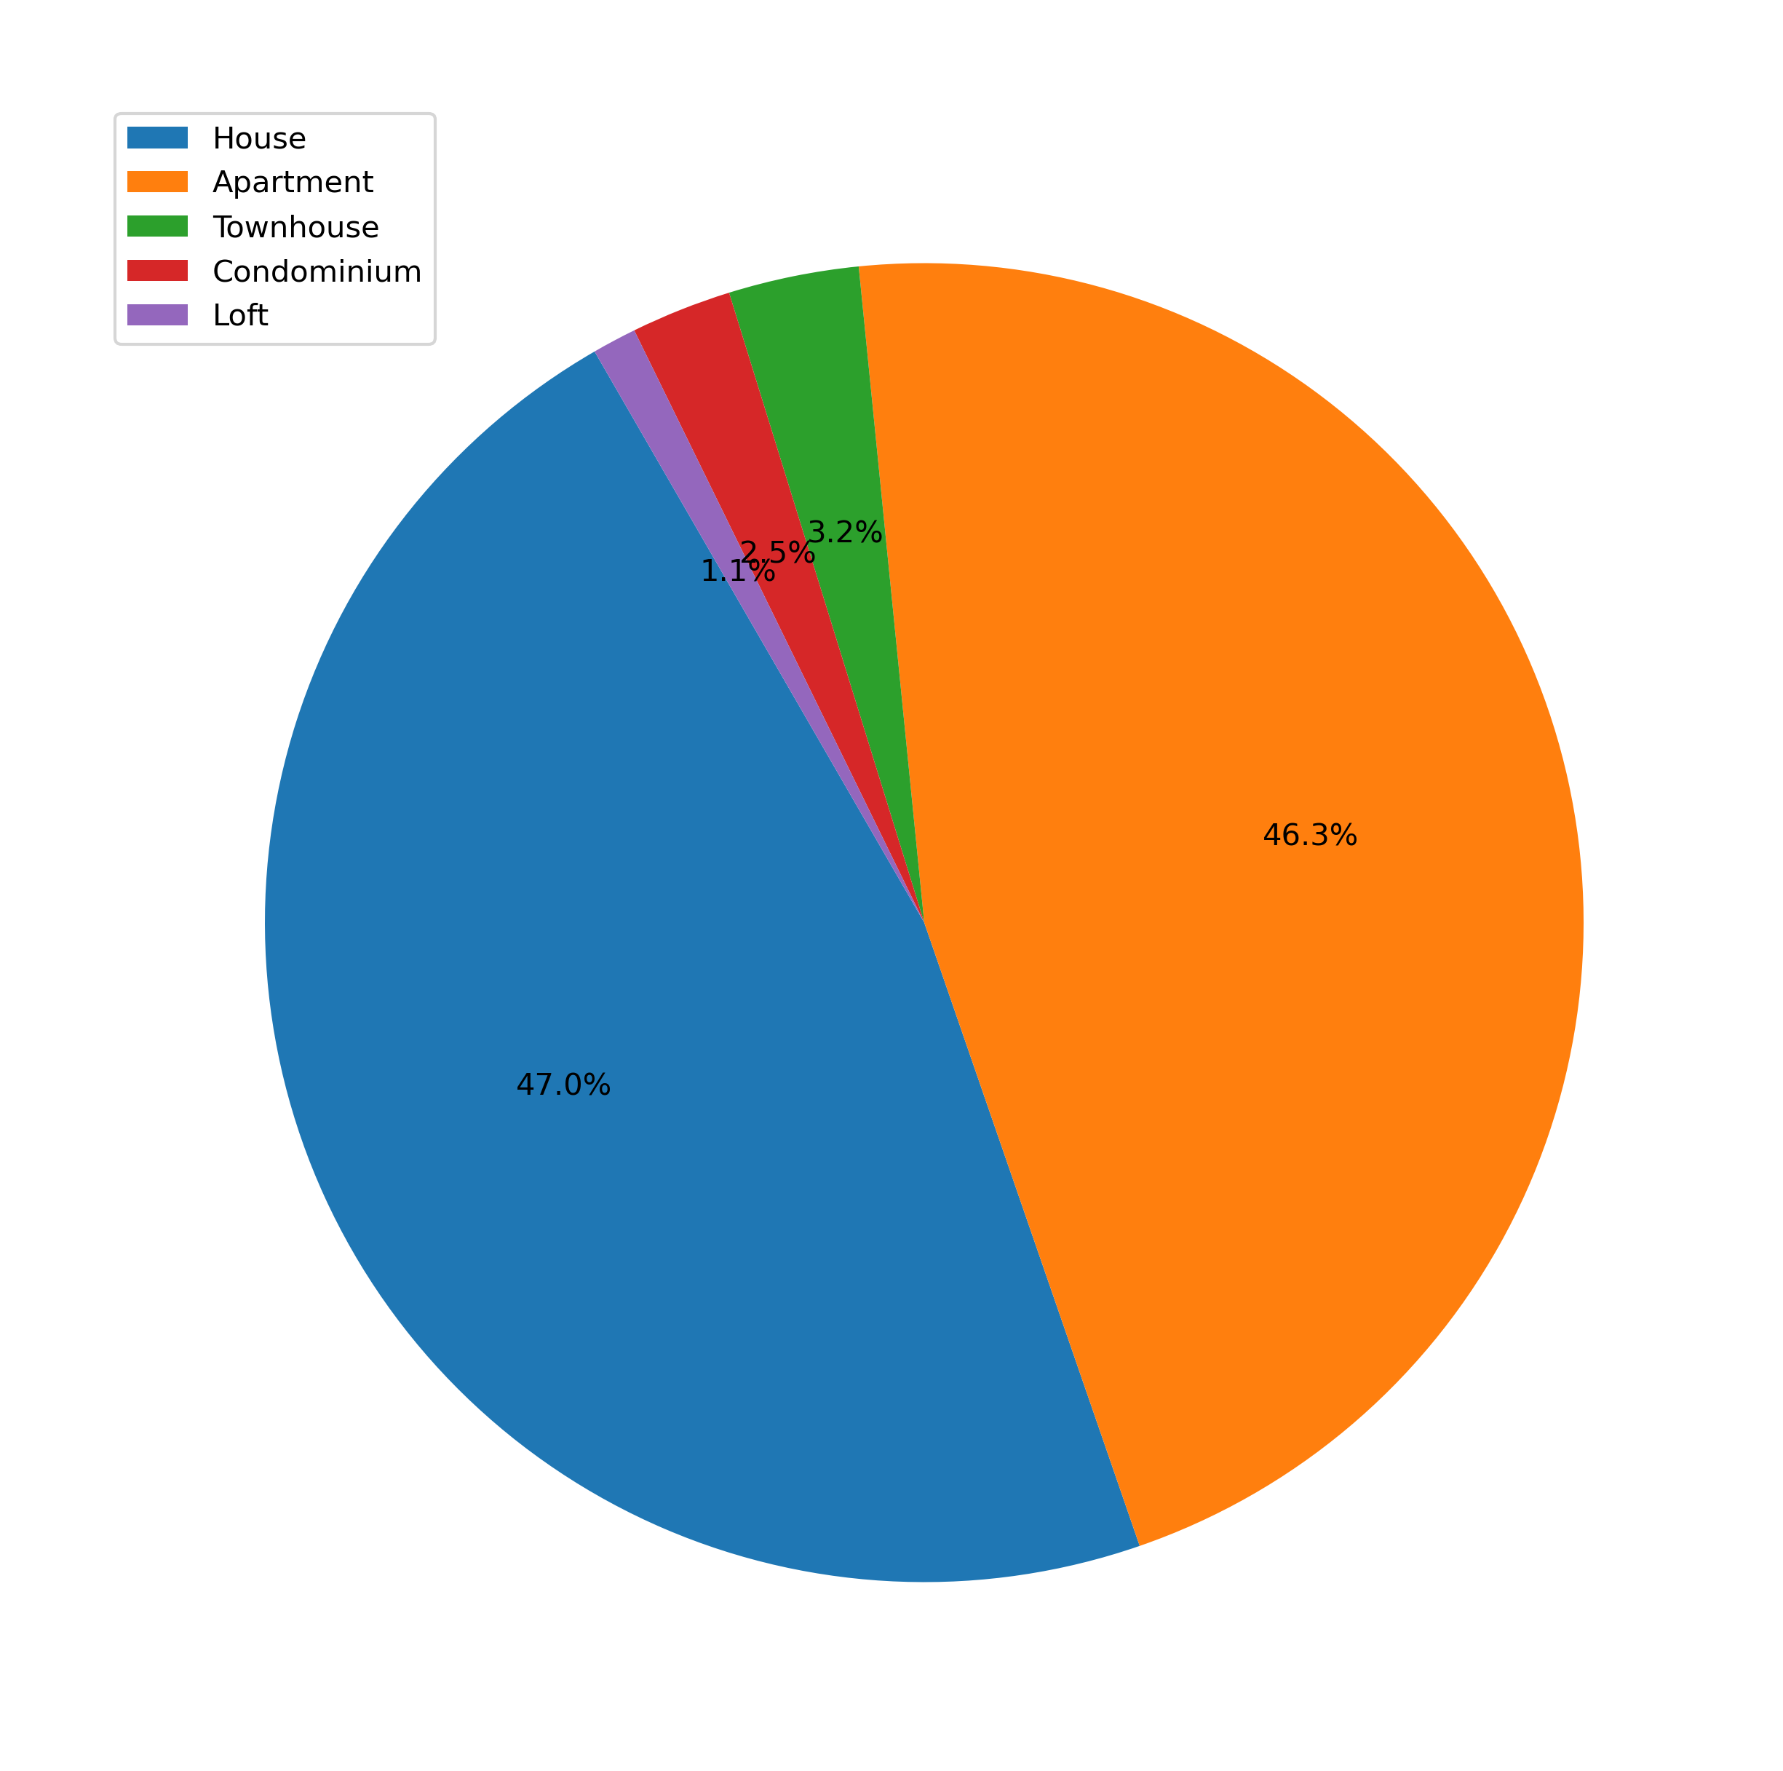
Types of Properties/
Rooms
2
Houses and Apartments reign supreme in Seattle!
93% chance of renting a house or apartment (vs next closest – townhouse at 3%)
Notes:
Caiti
Clear leader in what kind of property you can expect to rent when visiting Seattle…

Slide 10
Notes:
Caiti
…but for the more adventurous type, not to worry, there are 5 tents, 3 treehouses, and 1 yurt also available to rent!

Slide 11
Types of Properties/
Rooms
2
Go ahead, walk around in your bathrobe!
66.5% of available rentals give you domain over the entire house/apartment
Notes:
Caiti
Because most properties rentals are for the full house/apt, you can feel free to get comfortable while in Seattle.

Slide 12
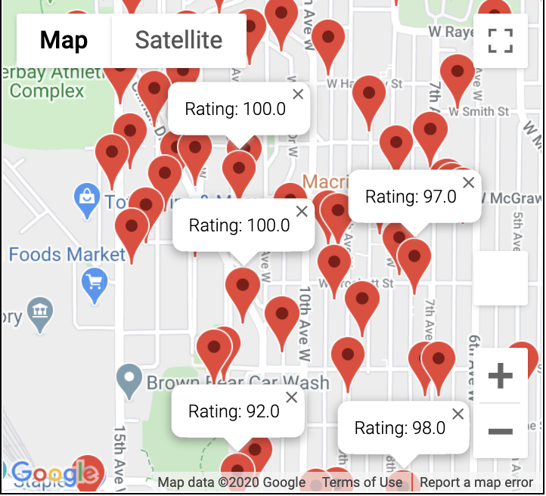

Types of Properties/
Rooms
2
We Seattle!
78% of properties have
an 80+ rating
Less than a third of all properties have a rating below 90!
PITCH DECK V 1.0
Notes:
Caiti
In fact, many people do just that, and end up really enjoying their stay. More than 78% of properties have an 80+ rating and the bulk majority (68%) are above 90.
[Transition to Yuly to discuss Types of Hosts and Conclusions]

Slide 13
3
Types of
Hosts
Home Sweet Home
2,751 unique hosts in Seattle
59.8% of hosts only offer a single property to rent (vs 12% of hosts who are using Airbnb as a business or side business)
Notes:
Yuly
The majority of hosts only offer one property for rent but there is a small percentage of the population that is using Airbnb as a way to make some real money through multiple property listings. The “host with the most” had 46 properties!

Slide 14
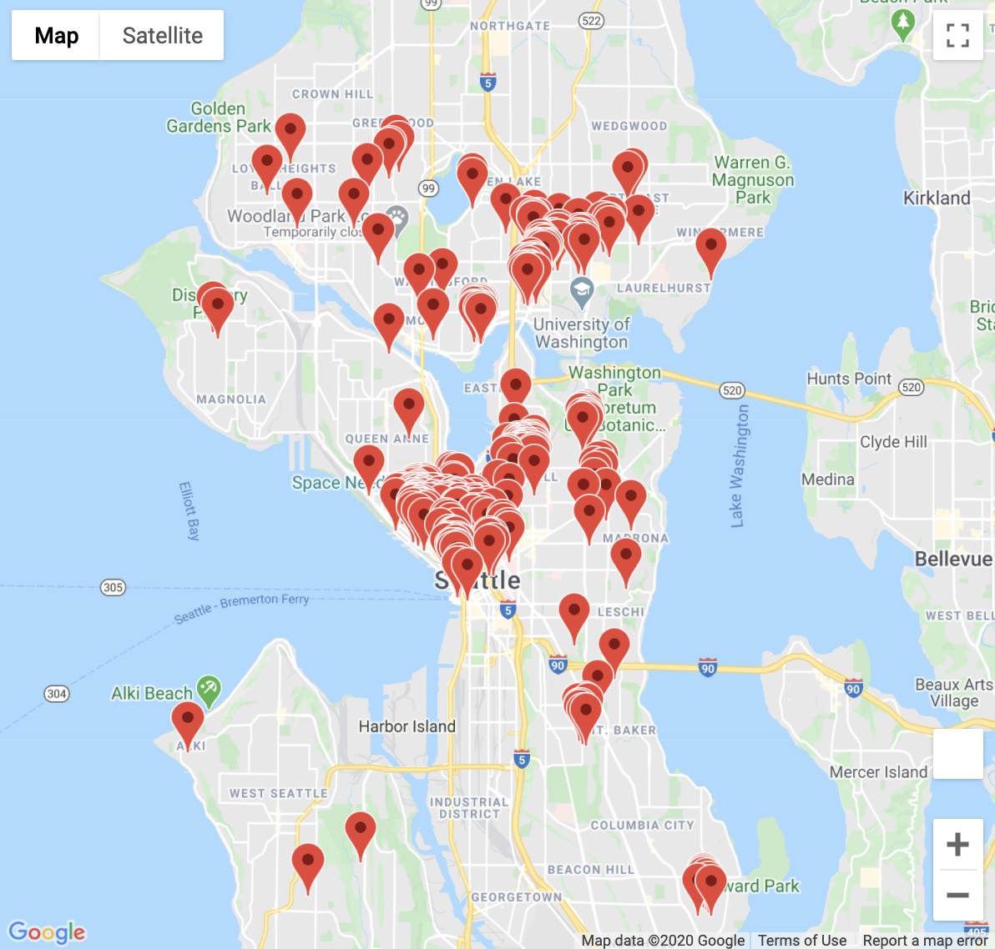
3
Types of
Hosts
Professional Hospitality vs Living Like a Local
Most Pro Hospitality listings are downtown (or by the university), making it more likely that you will have a “local” experience staying in the suburban neighborhoods
Notes:
Yuly
The 16 hosts who are using Airbnb as a business (offering 10+ properties) mainly offer properties in the downtown area or right by the university, so you’re more likely to have that “local” experience by heading to one of the more suburban neighborhoods.

Slide 15
Notes:
Yuly
So rent that minivan and channel your inner soccer mom!

Slide 16
Conclusion & Acknowledgments
Seattle is a cost-effective and enjoyable city to visit!
Low nightly prices and high ratings make this destination a great choice!
Given More Time…
Run the data on 1-2 other cities to create some comparisons
Look at activities, amenities, etc. by neighborhood
Build in general tourist information (i.e. monthly weather data, concert/sports events, etc.)
Notes:
Ultimately we believe this data model could be easily applied to the full global dataset for a complete guide to staying in Airbnbs around the world.
Given more time, we would have:
Processed 1-2 of the other cities’ data to demonstrate differences in Airbnb offerings in those cities and to begin the process of creating the Airbnb World Guide
Looked at various activities, amenities, etc. in some of the neighborhoods with the most properties to evaluate additional features and things to do when in Seattle and staying in an Airbnb
Recommend building in some general tourist information that could be useful to travelers (I.e. typical weather data by month, concert/sports events data, etc.)

Slide 17

Thank You!

Slide 18
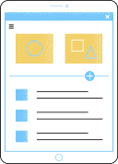

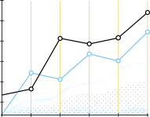







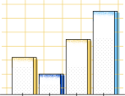




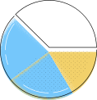
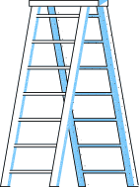




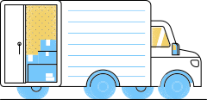


Icons/
Graphics
Use these free, recolourable icons and illustrations in your design.

